Slide 1
Introduction to Wavelets
By Burd Alex

Slide 2
List of topics
Why transform?
Why wavelets?
Wavelets like basis components.
Wavelets examples.
Fast wavelet transform .
Wavelets like filter.
Wavelets advantages.

Slide 3
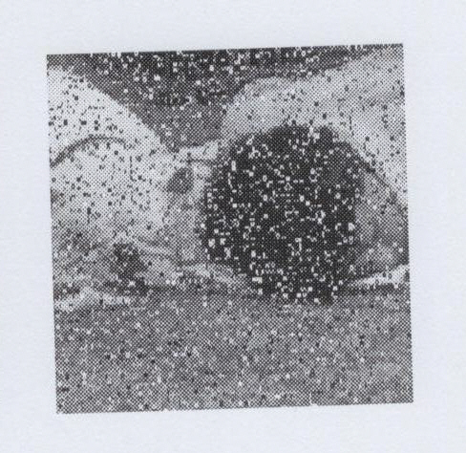
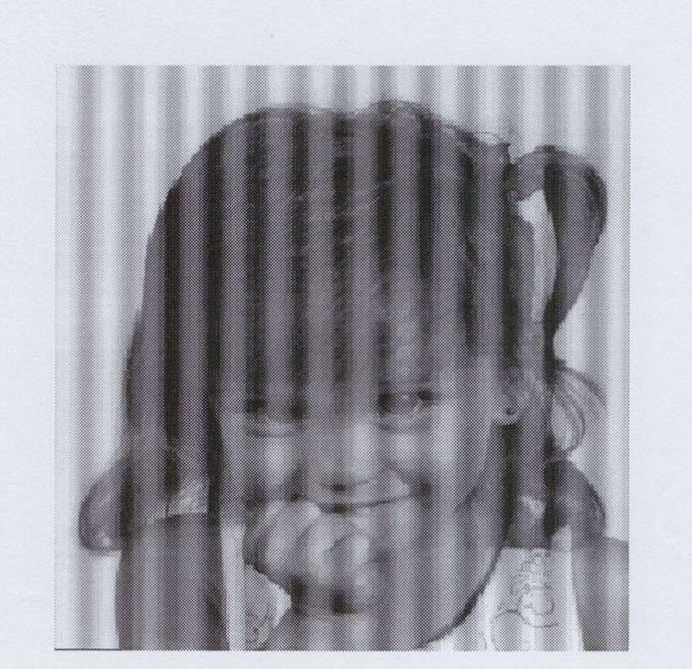
Why transform?

Slide 4
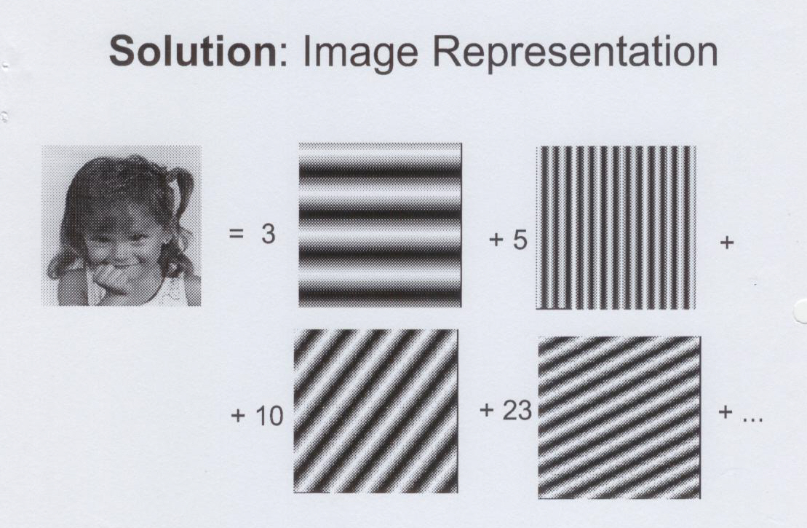
Image representation

Slide 5
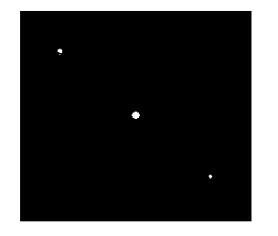
Noise in Fourier spectrum

Slide 6
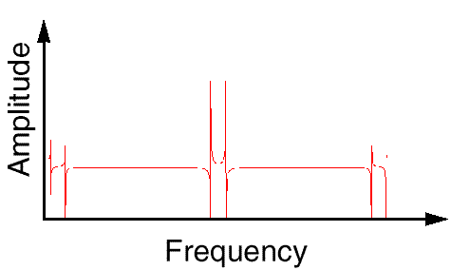
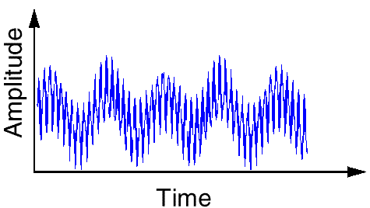
Fourier Analysis
Breaks down a signal into constituent sinusoids of different frequencies
In other words: Transform the view of the signal from time-base to frequency-base.

Slide 7
What’s wrong with Fourier?
By using Fourier Transform , we loose the time information : WHEN did a particular event take place ?
FT can not locate drift, trends, abrupt changes, beginning and ends of events, etc.
Calculating use complex numbers.

Slide 8
Time and Space definition
Time – for one dimension waves we start point shifting from source to end in time scale .
Space – for image point shifting is two dimensional .
Here they are synonyms .

Slide 9
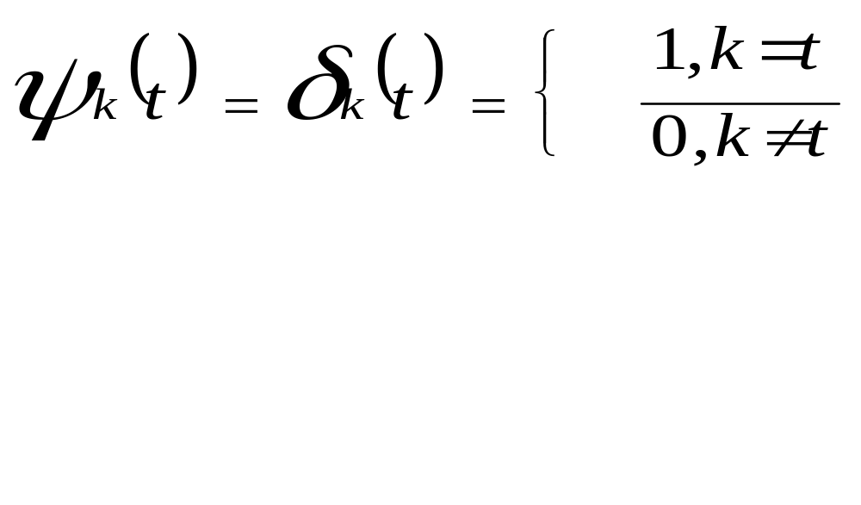
Kronneker function
Can exactly show the time of appearance but have not information about frequency and shape of signal.

Slide 10
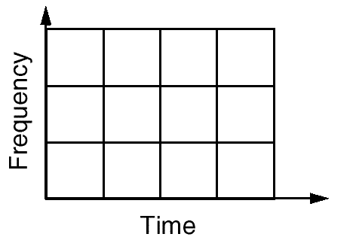
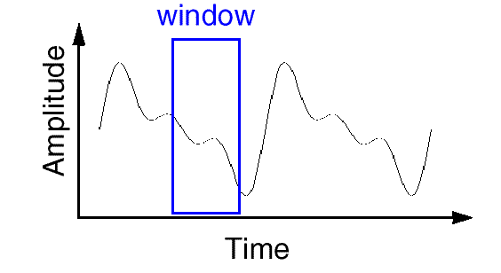
Short Time Fourier Analysis
In order to analyze small section of a signal, Denis Gabor (1946), developed a technique, based on the FT and using windowing : STFT

Slide 11
STFT (or: Gabor Transform)
A compromise between time-based and frequency-based views of a signal.
both time and frequency are represented in limited precision.
The precision is determined by the size of the window.
Once you choose a particular size for the time window - it will be the same for all frequencies.

Slide 12
What’s wrong with Gabor?
Many signals require a more flexible approach - so we can vary the window size to determine more accurately either time or frequency.

Slide 13
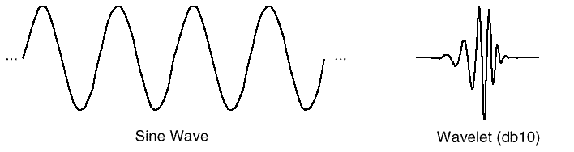
What is Wavelet Analysis ?
And…what is a wavelet…?
A wavelet is a waveform of effectively limited duration that has an average value of zero.

Slide 14
Wavelet's properties
Short time localized waves with zero integral value.
Possibility of time shifting.
Flexibility.

Slide 15
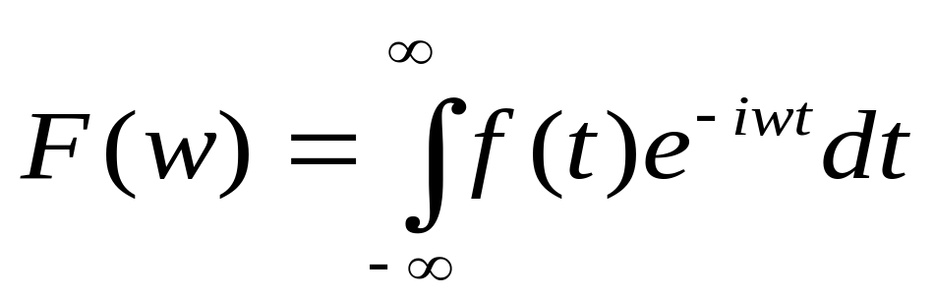
The Continuous Wavelet Transform (CWT)
A mathematical representation of the Fourier transform:
Meaning: the sum over all time of the signal f(t) multiplied by a complex exponential, and the result is the Fourier coefficients F() .

Slide 16
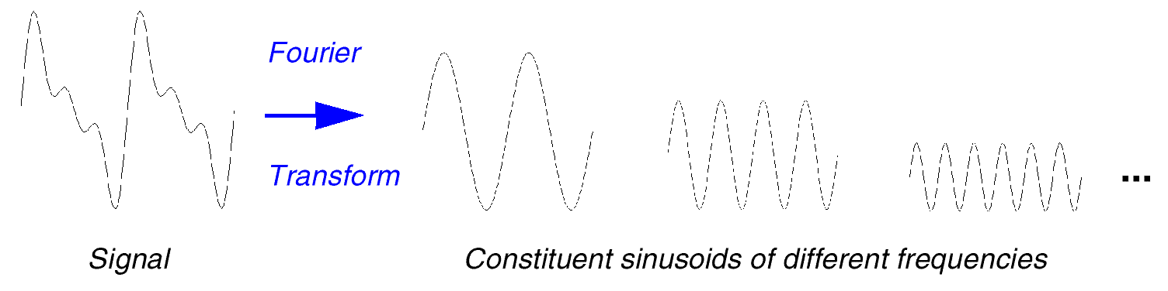
Wavelet Transform (Cont’d)
Those coefficients, when multiplied by a sinusoid of appropriate frequency , yield the constituent sinusoidal component of the original signal:

Slide 17
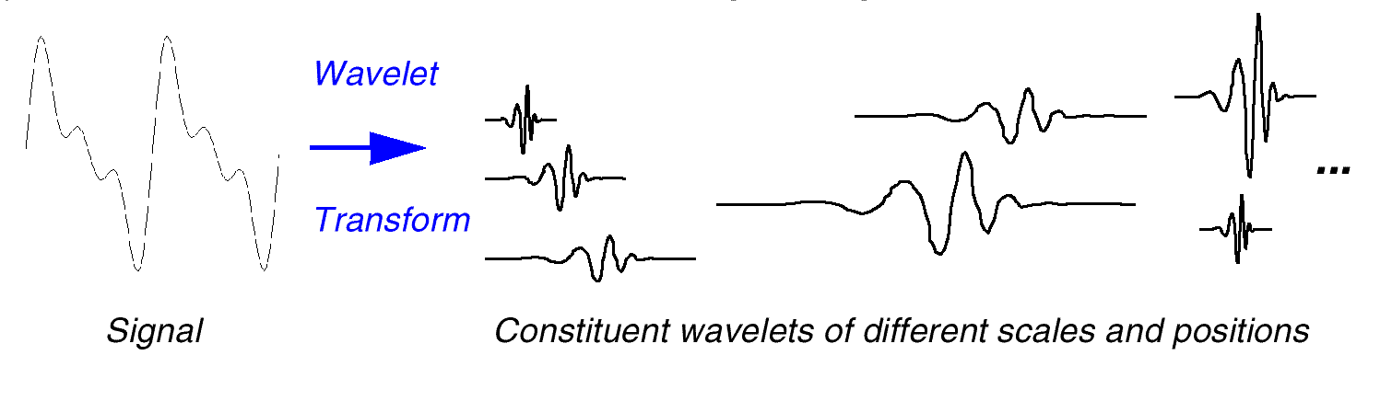
Wavelet Transform
And the result of the CWT are Wavelet coefficients .
Multiplying each coefficient by the appropriately scaled and shifted wavelet yields the constituent wavelet of the original signal:

Slide 18
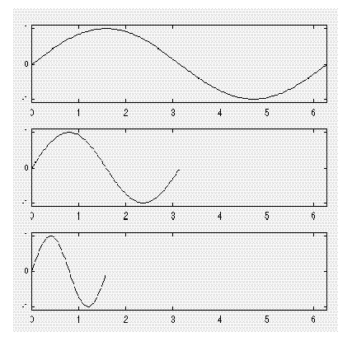
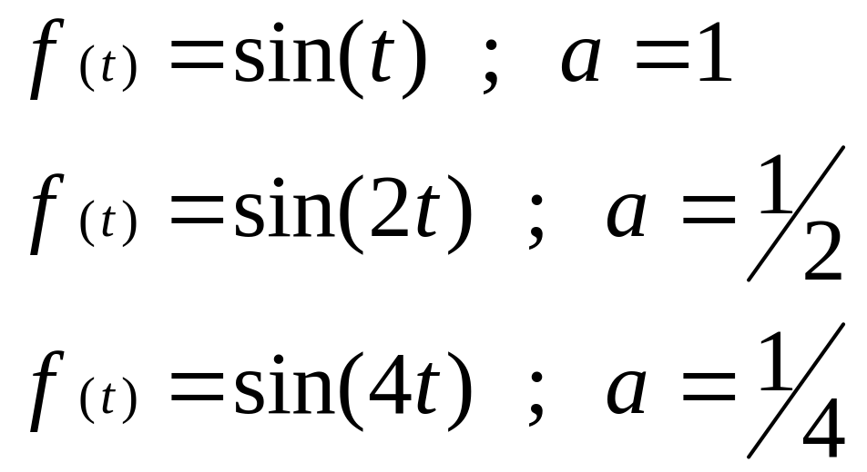
Scaling
Wavelet analysis produces a time-scale view of the signal.
Scaling means stretching or compressing of the signal.
scale factor (a) for sine waves:

Slide 19
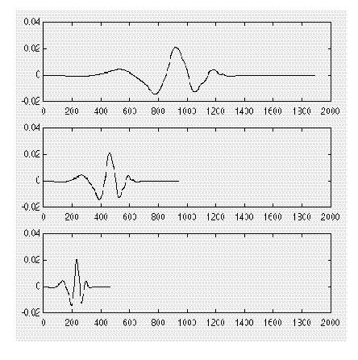
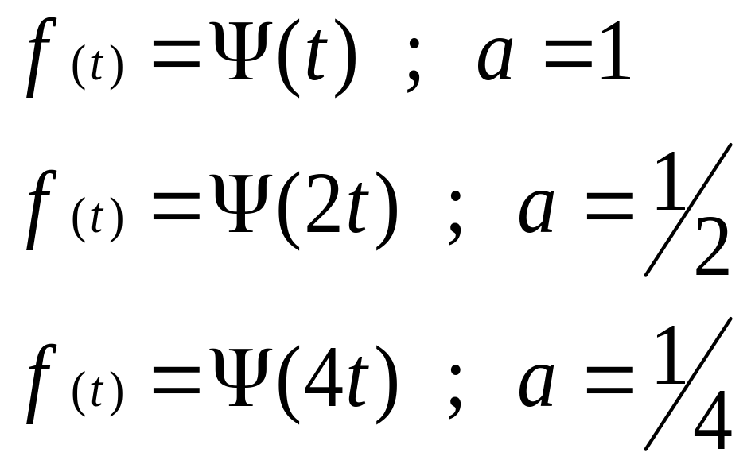
Scaling (Cont’d)
Scale factor works exactly the same with wavelets:

Slide 20
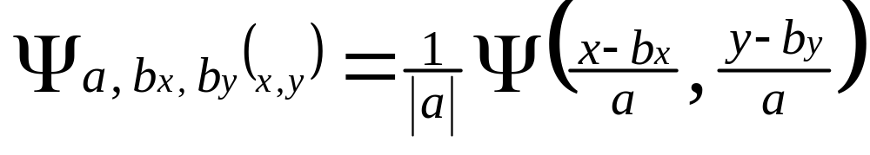
Wavelet function
(
)
b – shift coefficient
a – scale coefficient
2D function
Ψ
(
)
=
Ψ
−
1
x
b
a
,
b
x
a
a

Slide 21
CWT
Reminder: The CWT Is the sum over all time of the signal, multiplied by scaled and shifted versions of the wavelet function
Step 1:
Take a Wavelet and compare
it to a section at the start
of the original signal

Slide 22
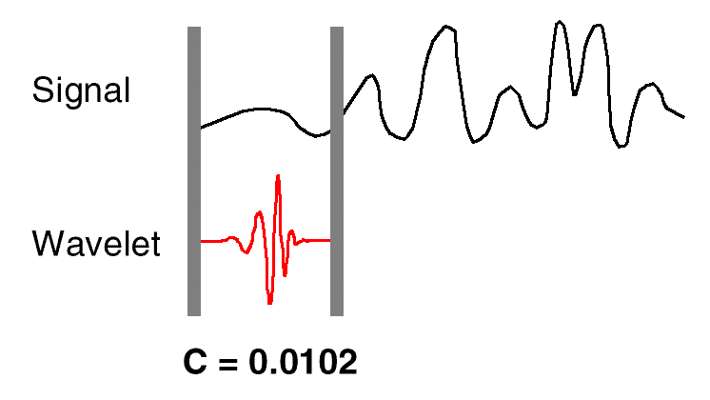
CWT
Step 2:
Calculate a number, C, that represents how closely correlated the wavelet is
with this section of the signal. The
higher C is, the more the similarity.

Slide 23
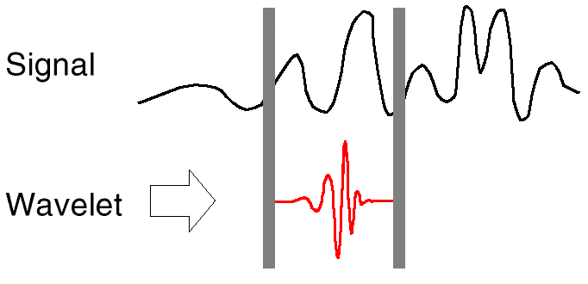
CWT
Step 3: Shift the wavelet to the right and repeat steps 1-2 until you’ve covered the whole signal

Slide 24
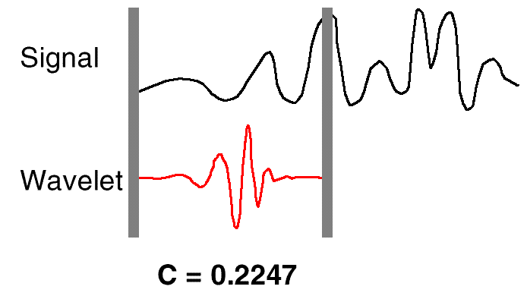
CWT
Step 4: Scale (stretch) the wavelet and repeat steps 1-3

Slide 25
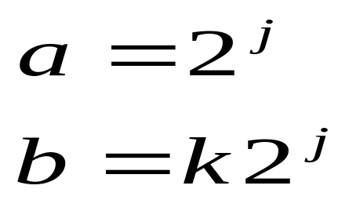
Wavelets examples
Dyadic transform
For easier calculation we can to discrete continuous signal.
We have a grid of discrete values that called dyadic grid .
Important that wavelet functions compact (e.g. no overcalculatings) .

Slide 26
Haar transform

Slide 27
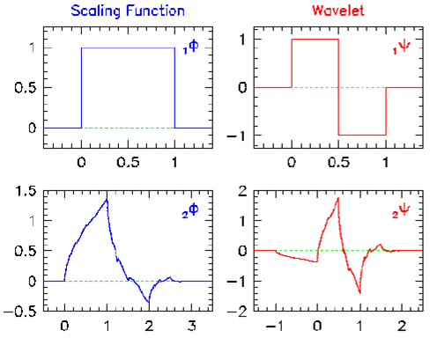
Wavelet functions examples
Haar function
Daubechies function

Slide 28
Properties of Daubechies wavelets
I. Daubechies, Comm. Pure Appl. Math. 41 (1988) 909.
Compact support
  finite number of filter parameters / fast implementations
  high compressibility
  fine scale amplitudes are very small in regions where the function is smooth / sensitive recognition of structures
Identical forward / backward filter parameters
  fast, exact reconstruction
  very asymmetric

Slide 29
Mallat* Filter Scheme
Mallat was the first to implement this scheme, using a well known filter design called “two channel sub band coder”, yielding a ‘Fast Wavelet Transform’

Slide 30
Approximations and Details:
Approximations: High-scale, low-frequency components of the signal
Details: low-scale, high-frequency components
LPF
Input Signal
HPF

Slide 31
Decimation
The former process produces twice the data it began with: N input samples produce N approximations coefficients and N detail coefficients.
To correct this, we Down sample (or: Decimate) the filter output by two, by simply throwing away every second coefficient.

Slide 32
Decimation (cont’d)
So, a complete one stage block looks like:
LPF
A*
Input Signal
HPF
D*

Slide 33
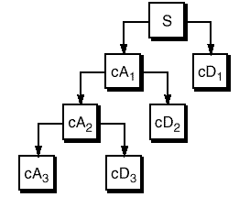
Multi-level Decomposition
Iterating the decomposition process, breaks the input signal into many lower-resolution components: Wavelet decomposition tree:

Slide 34
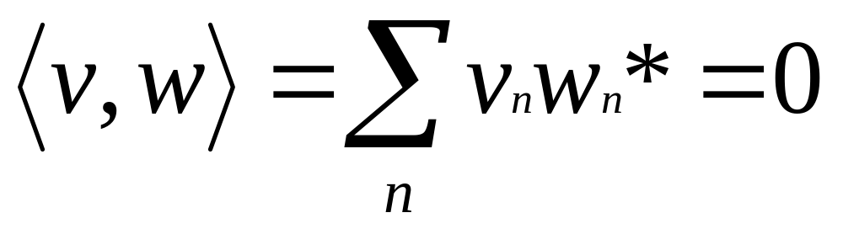
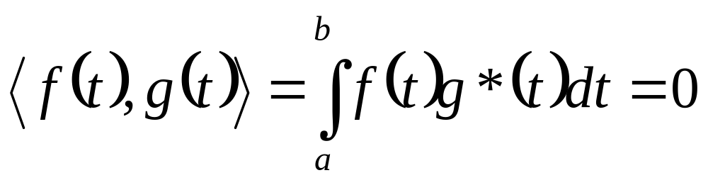
Orthogonality
For 2 vectors
For 2 functions

Slide 35
Why wavelets have orthogonal base ?
It easier calculation.
When we decompose some image and calculating zero level decomposition we have accurate values .
Scalar multiplication with other base function equals zero.

Slide 36
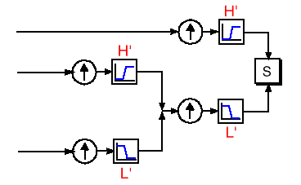
Wavelet reconstruction
Reconstruction (or synthesis) is the process in which we assemble all components back
Up sampling
(or interpolation) is done by zero inserting between every two coefficients

Slide 37
Wavelets like filters
Relationship of Filters to Wavelet Shape
Choosing the correct filter is most important.
The choice of the filter determines the shape of the wavelet we use to perform the analysis.

Slide 38
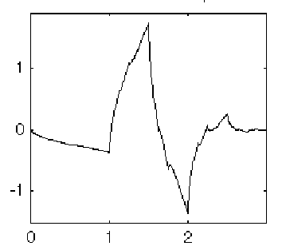
Example
A low-pass reconstruction filter (L’) for the db2 wavelet:
The filter coefficients (obtained by Matlab dbaux command:
0.3415 0.5915 0.1585 -0.0915
reversing the order of this vector and multiply every second coefficient by -1 we get the high-pass filter H’:
-0.0915 -0.1585 0.5915 -0.3415

Slide 39
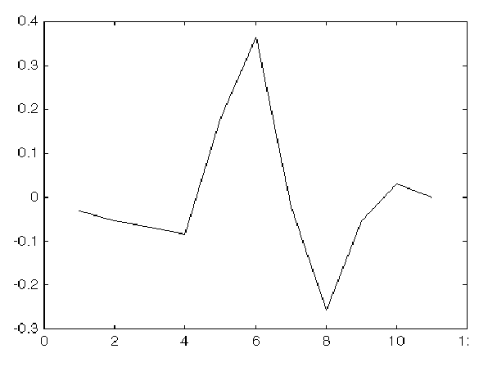
Example (Cont’d)
Now we up-sample the H’ coefficient vector:
-0.0915 0 -0.1585 0 0.5915 0 -0.3415 0
and Convolving the up-sampled vector with the original low-pass filter we get:

Slide 40
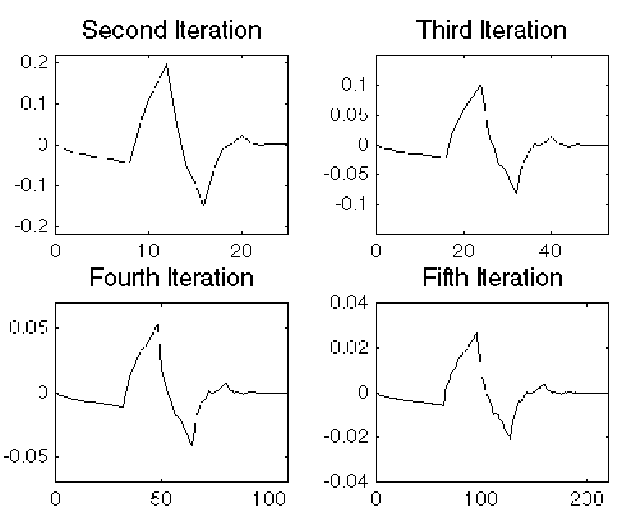
Example (Cont’d)
Now iterate this process several more times, repeatedly up-sampling and convolving the resultant vector
with the original
low-pass filter,
a pattern
begins to
emerge:

Slide 41
Example: Conclusion
The curve begins to look more like the db2 wavelet: the wavelet shape is determined entirely by the coefficient Of the reconstruction filter
You can’t choose an arbitrary wavelet waveform if you want to be able to reconstruct the original signal accurately!

Slide 42
Compression Example
A two dimensional (image) compression, using 2D wavelets analysis.
The image is a Fingerprint.
FBI uses a wavelet technique to compress its fingerprints database.

Slide 43
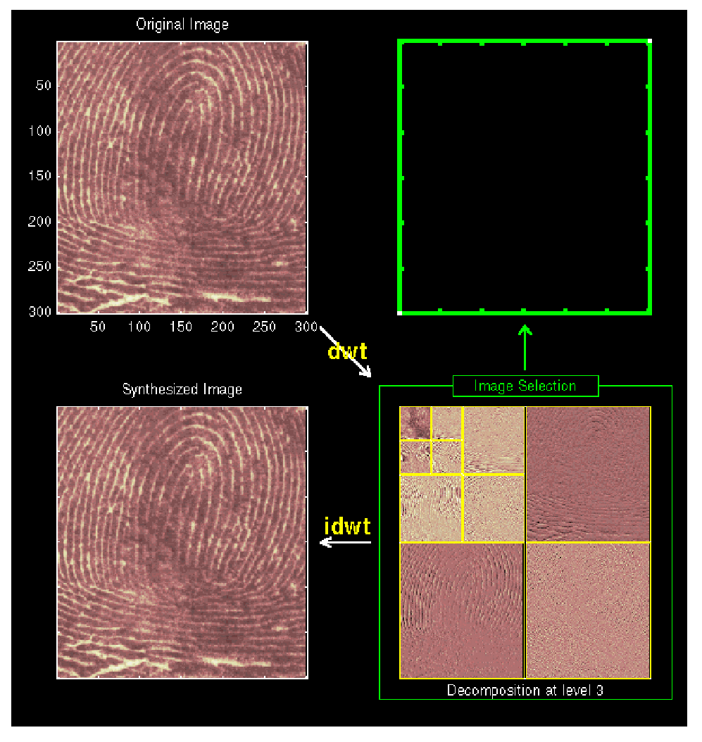
Fingerprint compression
Wavelet: Haar
Level:3

Slide 44
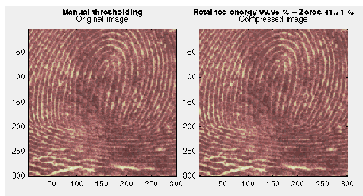
Results (1)
Original Image Compressed Image
Threshold: 3.5
Zeros: 42%
Retained energy:
99.95%

